Slide 1


Shield Insurance
Key Metrics & Insights from Power BI Dashboard Sept 2024

Slide 2


Company Overview
Shield Insurance Company provides reliable and comprehensive insurance plans for individuals and businesses, ensuring protection from various risks. Known for its commitment to customer care and security, Shield stands out in the market for its focus on coverage reliability, helping customers feel safe and secure.

Slide 3

Objective
Present key metrics including total customers, total revenue, daily revenue and customer growth, and month-over-month percentage change.
Analyze customer segmentation by age groups, cities, and sales modes to identify revenue and customer trends.
Showcase trends for customer and revenue growth with a toggle between graphs, and apply filters on key dimensions like sales mode, age group, city, and month.
Provide detailed analysis of sales mode trends, customer distribution, and revenue percentages by age group, city, and sales mode.
Explore age group behavior in relation to sales mode preferences, policy preferences, and expected settlements for further business insights.

Slide 4
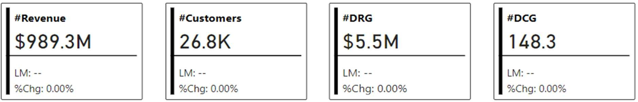
Key Metrics Overview
Total Revenue: ₹989.3M
Total Customers: 26.8K
Daily Revenue Growth (DRG): ₹5.5M
Daily Customer Growth (DCG): 148.3
The current metrics indicate strong financial health and stable customer acquisition. However, no change from the previous period suggests room for optimization to boost growth and sustain momentum.

Slide 5
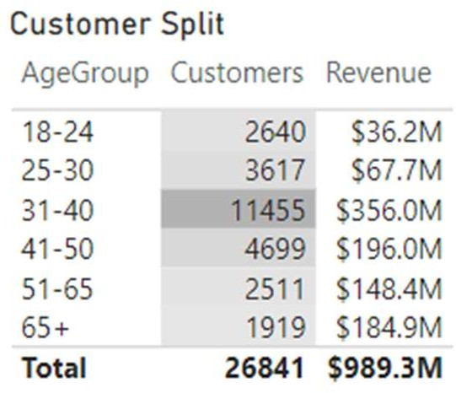
Revenue & Customer Distribution by Age Group
The 31-40 age group is the top revenue generator, contributing $356M from 11,455 customers.
The 41-50 age group follows with $196M, showcasing strong engagement from 4,699 customers.
Despite fewer customers, the 65+ group generates significant revenue of $184.9M,
indicating a high-value segment.

Slide 6
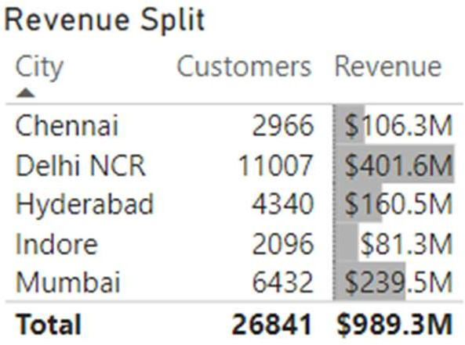
City-wise Revenue & Customer Segmentation
Delhi NCR is the largest revenue contributor, generating $401.6M from 11,007 customers, making it the most profitable region.
Mumbai follows with $239.5M from 6,432 customers, reflecting strong urban market penetration.
Chennai and Hyderabad also contribute
significantly, with $106.3M and $160.5M in revenue respectively, showing regional diversity in revenue generation.

Slide 7
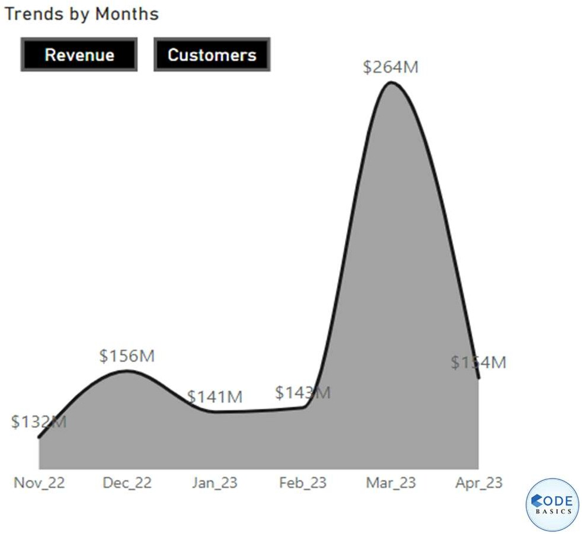
Revenue Trends by Month
Monthly Revenue: Fluctuations observed with a peak of ₹264M in March 2023, down to ₹143M in April 2023. Notably, revenue was ₹141M in January, reflecting volatility in the earlier part of the year.
Trend Insights: There was a significant spike in revenue in March, likely due to seasonal factors, followed by a steep decline in April. The drop from ₹264M to
₹143M between March and April suggests potential external market influences or operational shifts impacting revenue stability.

Slide 8
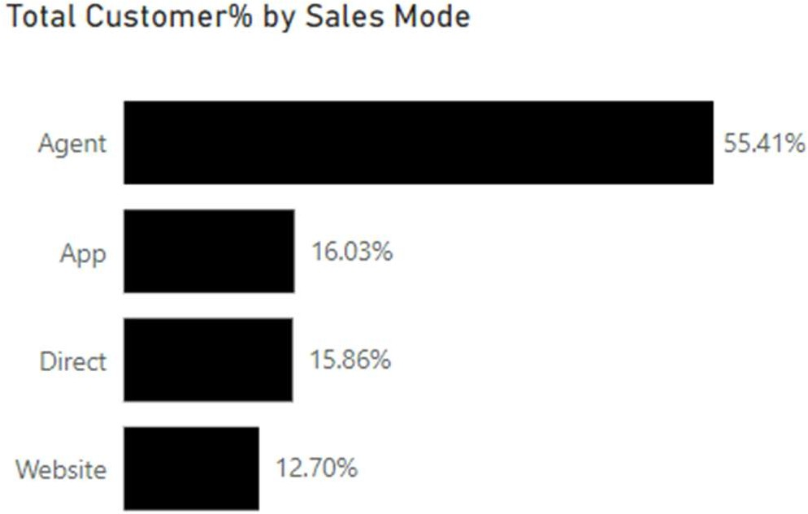
Sales Mode Distribution
The majority of Shield Insurance's sales are generated through Agents, accounting for 55.41% of total sales.
Other modes include App (16.03%), Direct (15.86%), and Website (12.70%), showing that offline channels (Agent and Direct) still play a significant role in sales.

Slide 9
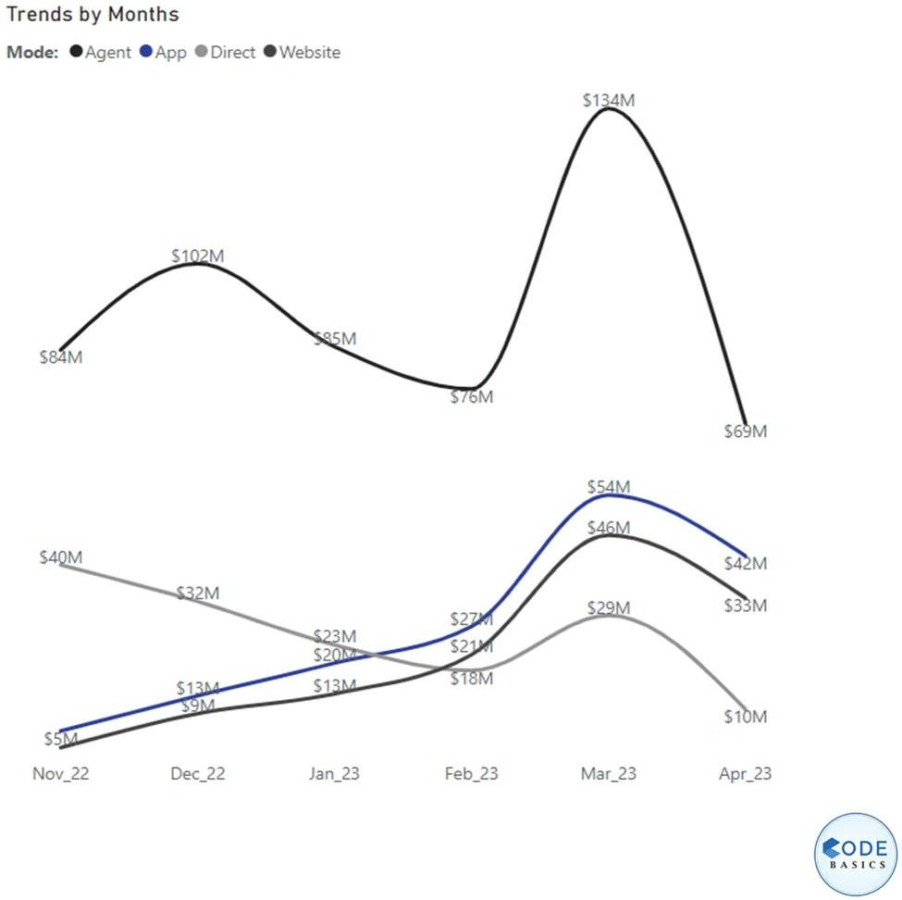
Monthly Revenue Trends
Revenue peaked in June 2023 at $134M, suggesting this may be a high season or there was a particular campaign or external factor driving sales.
After June, there was a noticeable decline, ending at $69M in August 2023, indicating potential seasonality or other market factors affecting sales.
The trend lines for other modes (Direct, App, Website) show steady growth, with Direct and Website modes consistently increasing in revenue through early 2023.

Slide 10
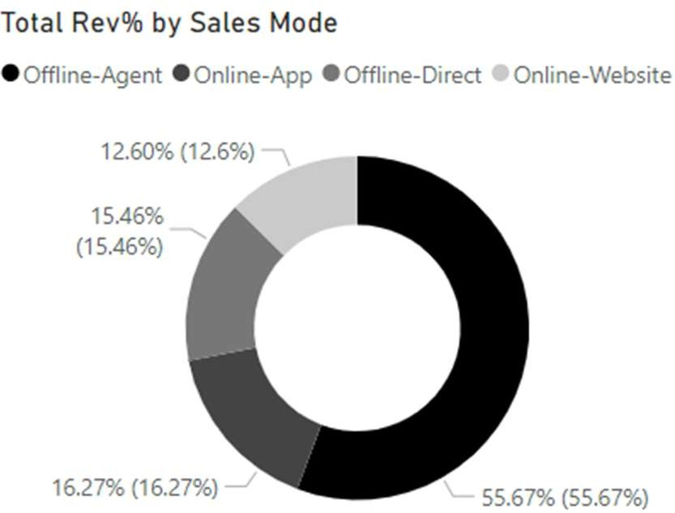
Revenue by Sales Mode
Agents contribute significantly to the revenue, mirroring the customer distribution. The Offline-Agent segment holds the highest share at 55.67%, followed by other online and offline channels.

Slide 11
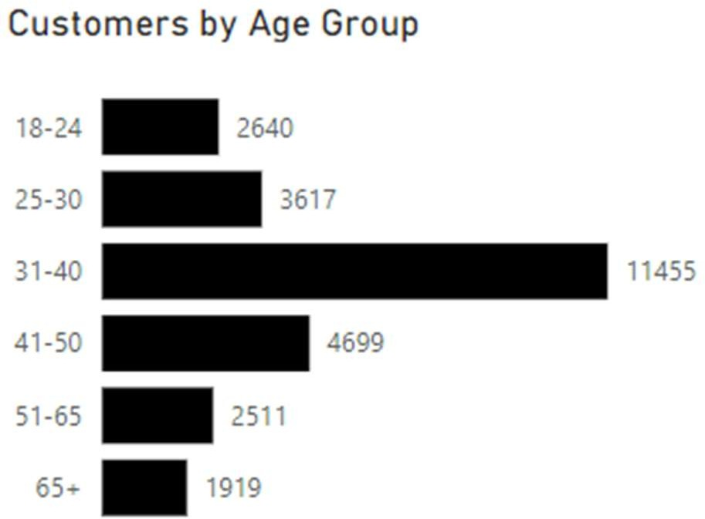
Customer Distribution by Age Group
The 31-40 age group has the highest number of customers at 11,455, which may indicate a demographic focus for the company.
The 41-50 and 25-30 age groups are the next largest segments, with 4,699 and
3,617 customers, respectively.
18-24 and 65+ age groups have relatively
lower representation, suggesting that younger and older demographics might be less engaged or have different insurance needs.

Slide 12
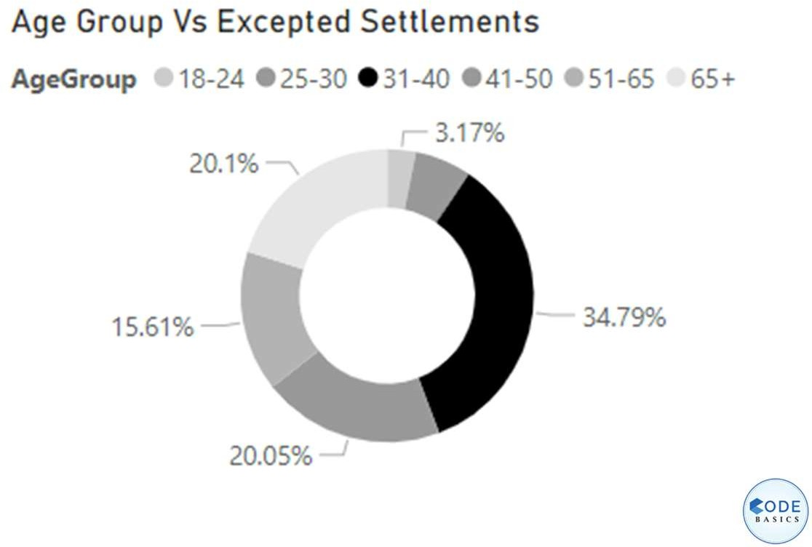
Expected Settlements by Age Group
The 31-40 age group holds the largest share of expected settlements at 34.79%, which might imply higher risk or claim activity within this group.
25-30 and 41-50 age groups also show notable settlement expectations, at 20.05%
and 20.1% respectively, which could inform
risk assessment and policy management strategies.

Slide 13
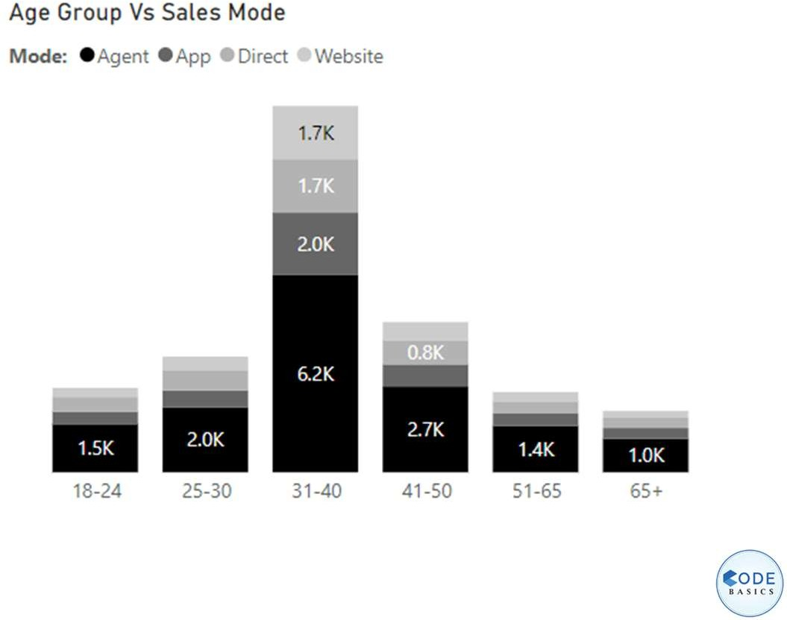
Age Group vs Sales Mode
Sales through agents are dominant across age groups, particularly in the 31-40 age group, further reinforcing the role of personal interaction in sales.
Online sales channels (App and Website)
are utilized more by younger age groups like 18-24 and 25-30, suggesting a preference for digital interfaces among younger customers.

Slide 14
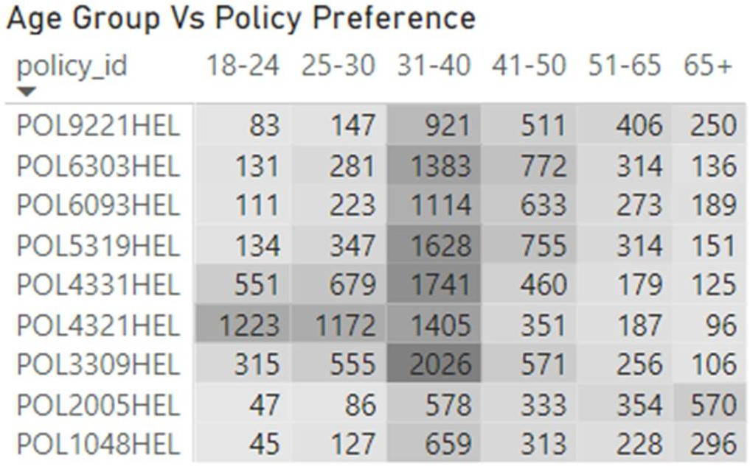
Policy Preference by Age Group
Policies are well distributed among age groups, with the 31-40 segment having the highest preferences for policies like POL9221HEL and POL3193HEL, indicating popular choices among this demographic.

Slide 15
Recommendation
Customer Growth & Stability: Use predictive analytics to manage revenue fluctuations and target younger (18-24) and older (65+) demographics to boost growth.
Age Group Focus: Strengthen retention efforts for the high-revenue 31-40 age group with tailored offerings.
Geographical Strategy: Apply successful strategies from Delhi NCR to other regions like Mumbai and Chennai for growth.
Sales Channel Optimization: Enhance digital platforms to better engage younger customers favoring online channels.
Policy & Risk Management: Develop tailored policies for high-settlement groups (31-40, 25-30, 41-50) to improve risk management.
Product & Channel Strategy: Customize product offerings by age group to match preferences and optimize multi-channel engagement.

Slide 16
Resources
Image Source: www.google.com
Data Analytics Internship: www.codebasics.io Live Power BI Dashboard: click to view
Interactive report by
Padma Ch. Behera @ Data Analyst
Do you have any question related to presentation? Please email padmachbehera23@gmail.com

